Slide 1


Slide 2




Who’s going to build the future?
Blockchain developers are in short supply
188 have plans to implement
Blockchain technology
Survey of 200
Fortune 500
Executives:
Only 12 could find engineers to do it
Source: Synechron

Slide 3

Who’s going to build the future?
Blockchain developers are in short supply
There are currently 14 open jobs for every blockchain engineer

Slide 4

The Blockchain job market is forecast to
grow 16x in the next 7 years
Source: Grand View Research

Slide 5
What happens if market growth continues, but there’s no course correction?
Potential for an industry-wide bottleneck
Threat of sector implosion
Blockchain projects stalled indefinitely
BUT also a RARE OPPORTUNITY for Blockchain Developers

Slide 6

Why has the Blockchain ecosystem been
slow to train new developers?

Slide 7

Blockchain tech moves too quickly to be integrated into most traditional curriculum structures
Blockchain devs are paid more to develop than to document or teach
There’s a lack of industry standards for education and certification
3 Critical Challenges:

Slide 8

What’s the Solution?
The World’s First Accredited School for Blockchain
- Full suite of blockchian educational solutions -

Slide 9
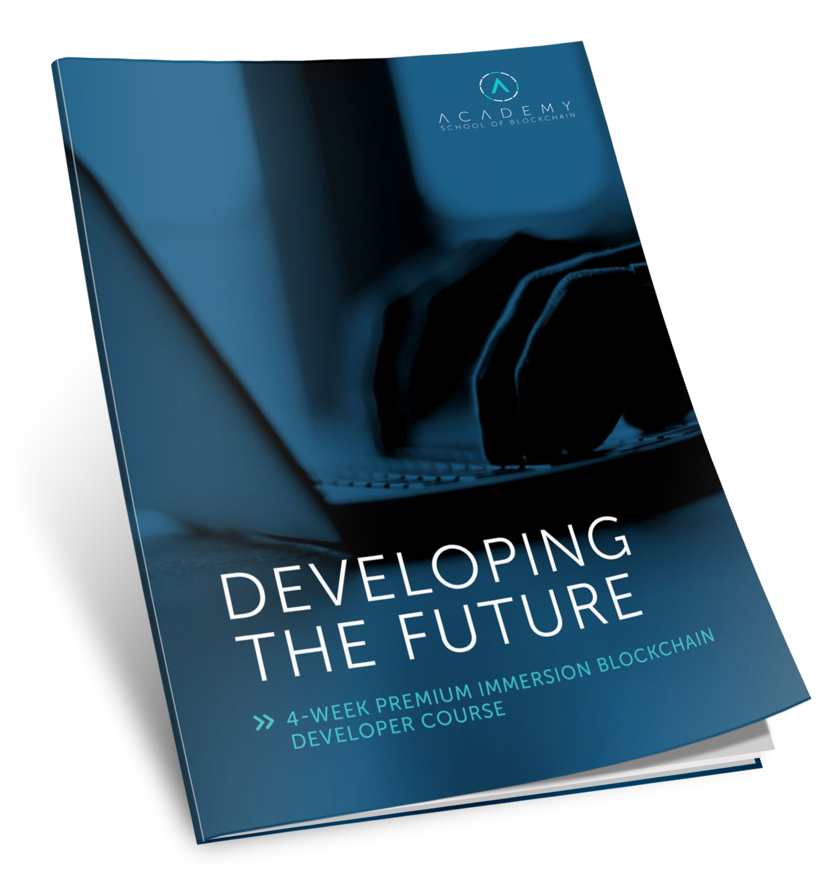
8-10 Week Immersive
Blockchain Curriculum
To convert Software Developers into Blockchain Engineers
Learn fundamentals of blockchain networks and advanced smart contracts
‘Doing’ vs ‘Knowing’ for Job Readiness
Companies looking for graduates

Slide 10
During This Program, Students Will:
BLOCKCHAIN INTRODUCTION
BLOCKCHAIN CRYPTOGRAPHY
CONSENSUS ALGORITHMS
PRACTICAL PROJECT: NODES, TRANSACTIONS, BLOCKCHAINS, PEERS AND CONSENSUS
MINING AND MINING POOLS
WALLETS AND APIS
TRANSACTIONS AND EXCHANGES
WORKING ON THE PRACTICAL PROJECT: WALLETS, FAUCETS, AND BLOCK EXPLORER
OFFCHAIN TRANSACTIONS
ANONYMOUS TRANSACTIONS
INTRODUCTION TO ETHEREUM
SOLIDITY BASICS
SOLIDITY ADVANCED
TRUFFLE AND GANACHE
DAPPS, WEB3, METAMASK, AND IPFS
DAPP PRACTICAL PROJECT: ARCHITECTURE AND UI
SERVERSIDE ETHEREUM APIS
BLOCKCHAIN AND SMART CONTRACT SECURITY
OTHER BLOCKCHAIN PLATFORMS
Register to get a detailed curriculum

Slide 11
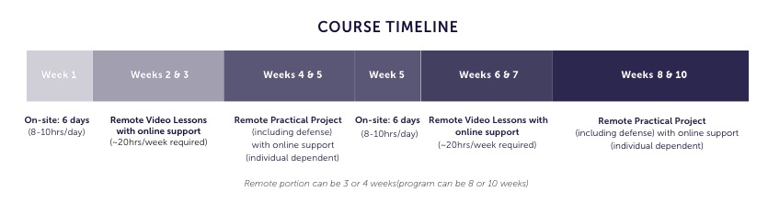

PROGRAM OVERVIEW - HYBRID IMMERSION
The Hybrid Immersion program has been developed to accommodate those already working in a professional environment It covers the same content as our Full Immersion Blockchain Developer program through a blend of face-to-face intensive training and online supported instruction.
The Hybrid Immersion Course is comprised of two courses; each containing 10 topic modules, and a personal/group project and public project defense. The first course, Blockchain Networks, is followed by the second course, DApps & Solidity.
Blockchain Networks
DApps

Slide 12
Why Kingsland’s Program?
Track record & passion for effective training (for job readiness)
Dedication to most up-to-date curriculum & access to information
Experience ‘doing & building’ (not only academia)
Strong placement support both local & international

Slide 13
Successfully delivered global education programs for nearly a decade
Over 275,000 students worldwide (i.e. US, Bulgaria)
History of 90+% placement rate in relevant jobs
SACS-CASI Accreditation
Track Record for Impact Training

Slide 14
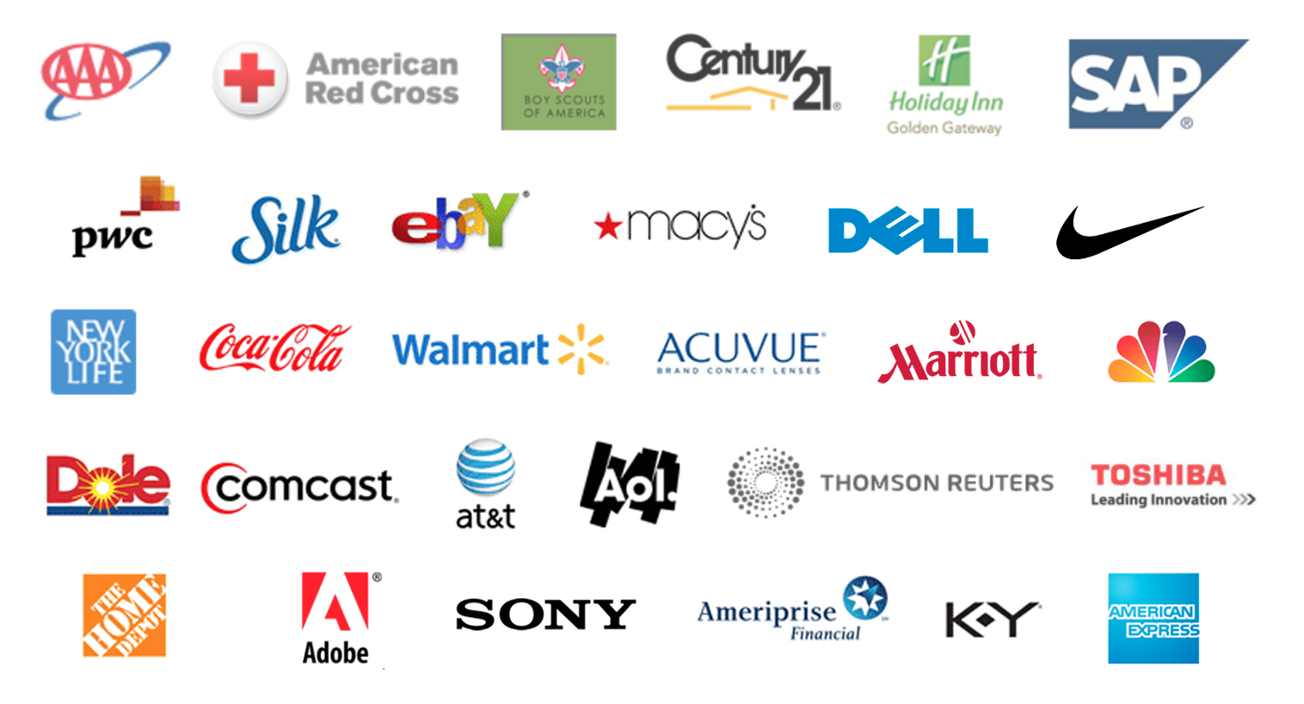
Trusted by some of the world’s most respected companies, universities, government agencies and not-for-profits, and have delivered our award-winning programs for:
Award
Winning
Education
Provider

Slide 15
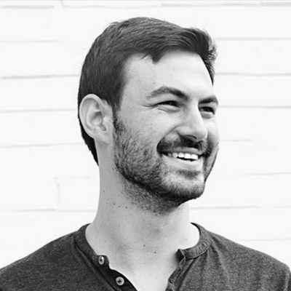
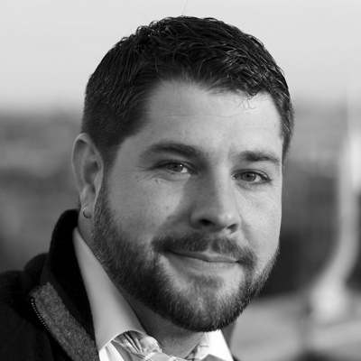
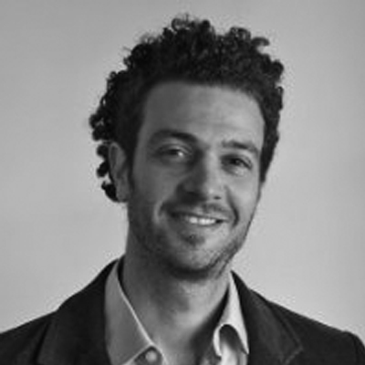

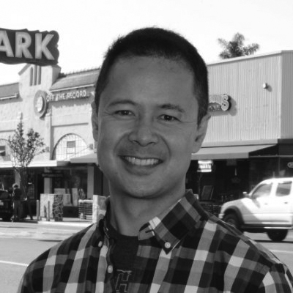
Curriculum Advisors & Development
A World-Class Curriculum Designed & Updated By Developers
Steve Dakh
Ethereum, Kryptokit
Craig Sellars
Tether, Omni, vAtomic
Gabriel Kurman
RSK Labs
Riccardo Spagni
Monero
Paul
Puey
Edge, Airbits
Currently, SIX Full-time Curriculum Developers
Constant Curriculum Updates (~every 2+ Weeks)!

Slide 16



OUTSOURCING.
Quickly and effectively increase your company’s capacity to deliver
high-value blockchain projects with the flexibility to scale up or scale down your blockchain developer needs depending on project demands.
1
OUT-STAFFING.
Get access to the world’s most diverse and highly-talented pool of blockchain developers, allowing you to focus on core aspects of your business, without the distraction and cost of staff recruitment and retention.
Bulgaria, Philippines, more centers in the works…

Slide 17
A Selection of Companies Seeking Kingsland Certified Developers
To date, we have over 9,000 requests

Slide 18
Why Kingsland’s Program?
Track record & passion for effective training (for job readiness)
Dedication to most up-to-date curriculum & access to information
Experience ‘doing & building’ (not only academia)
Strong placement support both local & international

Slide 19

DEVELOPERS:
Join our course in Seoul (1st week Sept).
Register to take assessment exam for potential scholarships
CORPORATES:
Send employees to the training and
Recruit our certified blockchain engineers
kingsland.academy/seoul/
robert@kingsland.academy

